Slide 1

CSE 3521: Introduction to Artificial Intelligence
[Many slides are adapted from the UC Berkeley. CS188 Intro to AI at UC Berkeley and previous CSE 3521 course at OSU.]

Slide 2
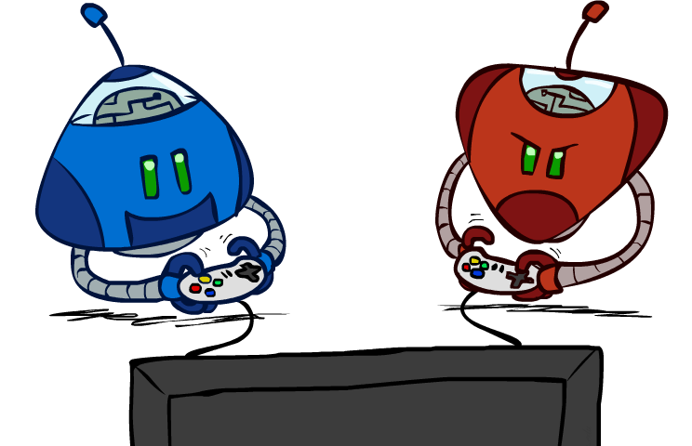
Today
Adversarial search
Minimax
Speedup: Evaluation functions
Speedup: pruning
Expectimax

Slide 3
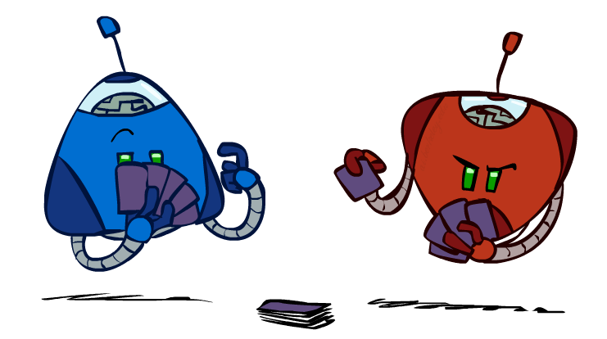
Game-Playing Agents
Many different kinds of games!
Axes:
Deterministic or stochastic?
One, two, or more players?
Zero sum?
Perfect information (can you see the state)?
Want algorithms for calculating a strategy (i.e., agent function, policy) which recommends a move (action) from each state

Slide 4
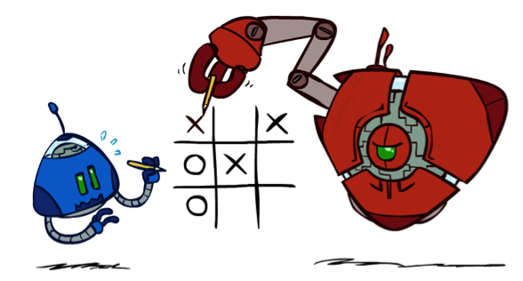
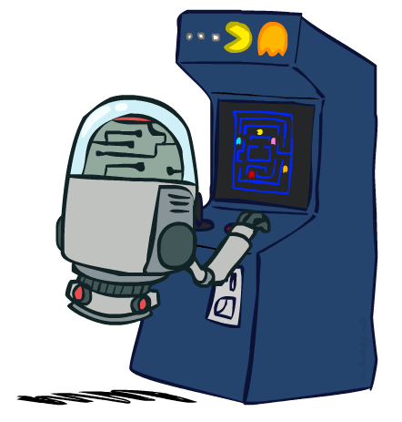
Deterministic Games
Many possible formalizations, one is:
States: S (start at s₀)
Players: P={1...N} (usually take turns)
Actions: A (may depend on player / state)
Transition Function: S x A → S
Terminal Test: S → {t, f}
Terminal Utilities: S x P → R
Solution for a player is a policy: S → A
Question: does the above imply “fully-observability”?

Slide 5
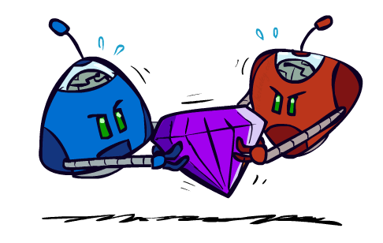
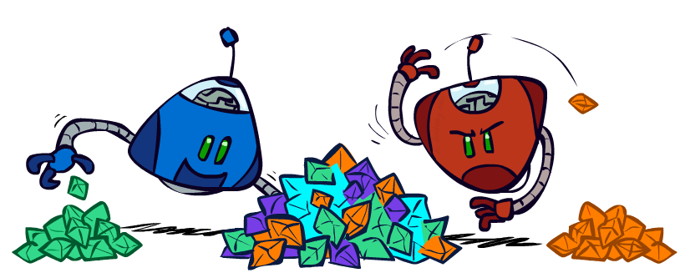
Types
Zero-Sum Games
General Games
Agents have opposite utilities (values on outcomes)
Lets us think of a single value that one maximizes and the other minimizes
Adversarial, pure competition
Agents have independent utilities (values on outcomes)
Cooperation, indifference, competition, and more are all possible

Slide 6

Adversarial Search for Adversarial Games
What to do?:
Arrive at terminal state
Maximize the “utility”
Question: which action to choose?

Slide 7
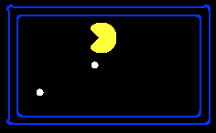
Single-Agent Trees
8
Utility may show up only when the game is terminated
Hard to apply search
2
0
…
2
6
…
4
6

Slide 8
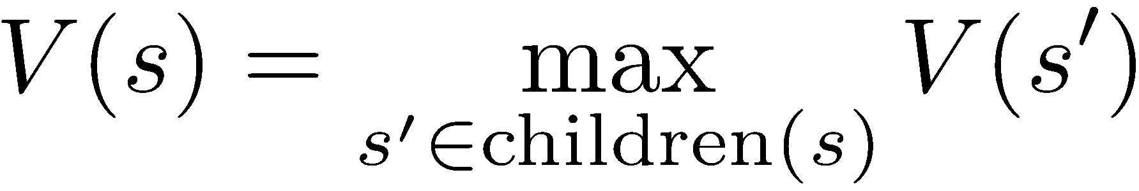
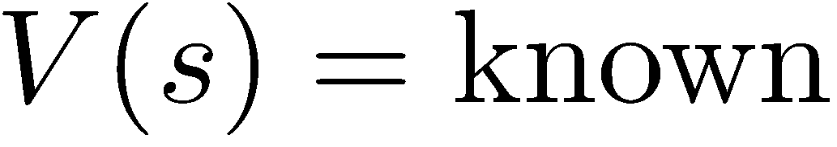
Value of a State
Value of a state: The best achievable outcome (utility) from that state
Non-Terminal States:
8
2
0
…
2
6
…
4
6
Terminal States:

Slide 9

Adversarial Game Trees
-20
-8
…
-18
-5
…
-10
+4
-20
+8

Slide 10
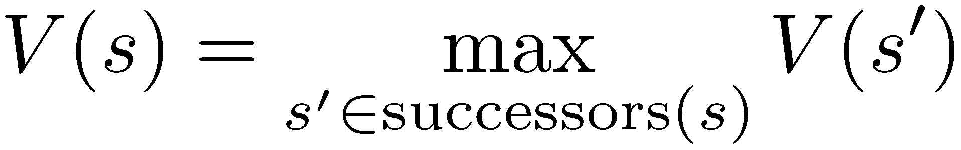
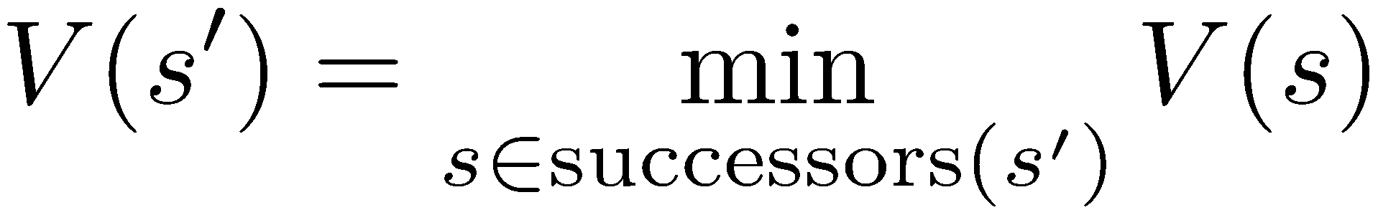
Minimax Values
States Under Agent’s Control:
States Under Opponent’s Control:
-8
-5
-10
+8
Terminal States:

Slide 11

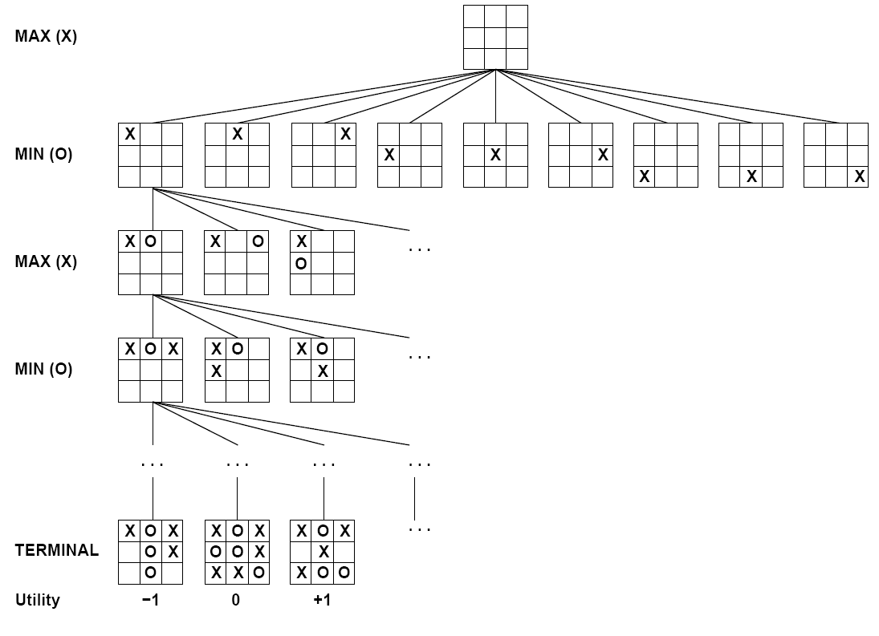

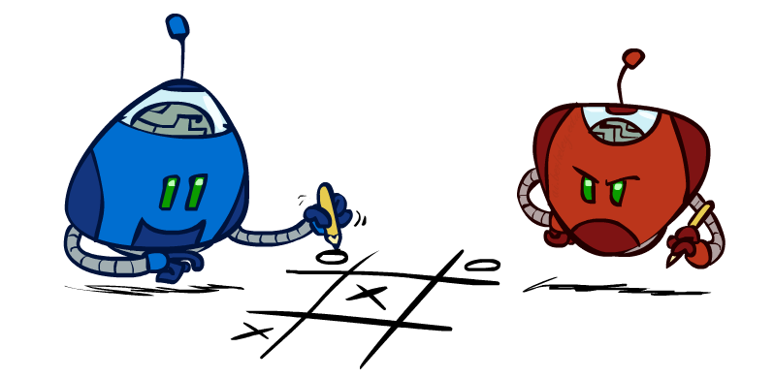
Tic-Tac-Toe Game Tree
Notes:
We are max

Slide 12
Tic-Tac-Toe Game Tree

Slide 13
Tic-Tac-Toe Game Tree

Slide 14
Tic-Tac-Toe Game Tree

Slide 15
Tic-Tac-Toe Game Tree

Slide 16
Tic-Tac-Toe Game Tree

Slide 17
Adversarial Search (Minimax)
Deterministic, zero-sum games:
Tic-tac-toe, chess, checkers
One player maximizes result
The other minimizes result
Minimax search:
A state-space search tree
Players alternate turns
Compute each node’s minimax value: the best achievable utility against a rational (optimal) adversary
Minimax values: computed recursively
5
max
2
5
min
8
2
5
6
Terminal values: part of the game

Slide 18
Minimax Implementation
def max-value(state):
initialize v = -∞
for each successor of state:
v = max(v, min-value(successor))
return v
def min-value(state):
initialize v = +∞
for each successor of state:
v = min(v, max-value(successor))
return v

Slide 19
Minimax Implementation (Dispatch)
def value(state):
if the state is a terminal state: return the state’s utility
if the next agent is MAX: return max-value(state)
if the next agent is MIN: return min-value(state)
def max-value(state):
initialize v = -∞
for each successor of state:
v = max(v, value(successor))
return v
def min-value(state):
initialize v = +∞
for each successor of state:
v = min(v, value(successor))
return v
Notes:
Pick an order for two reasons: sequential processor and pruning

Slide 20
Minimax Example
3
12
8
2
4
6
14
5
2
Don’t know the middle nodes values before reaching the terminal states

Slide 21
Minimax Efficiency
How efficient is minimax?
Just like (exhaustive) DFS: “for each successor”
Time: O(b^{m})
Space: O(bm)
Example: For chess, b ≈ 35, m ≈ 100
Exact solution is completely infeasible
But, do we need to explore the whole tree?

Slide 22
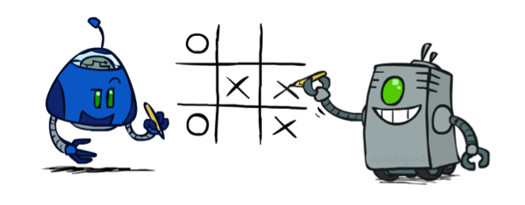
Minimax Properties
max
min
10
10
9
100
Optimal against a perfect player
May get better utility but may not be optimal, when MIN not play optimally

Slide 23
Resource Limits
4
max
Problem: In realistic games, cannot search to leaves!
Solution: Depth-limited search
Instead, search only to a limited depth in the tree
Replace terminal utilities with an evaluation function for non-terminal positions (e.g., via machine learning)
Example:
Suppose we have 100 seconds, can explore 10K nodes / sec
So can check 1M nodes per move
~ depth 8 – decent chess program
Guarantee of optimal play is gone
More plies makes a BIG difference
Use iterative deepening for an anytime algorithm
-2
4
min
-1
-2
4
9
?
?
?
?

Slide 24


Depth Matters
Evaluation functions are always imperfect
The deeper in the tree the evaluation function is buried, the less the quality of the evaluation function matters
An important example of the tradeoff between complexity of evaluation functions and complexity of computation

Slide 25
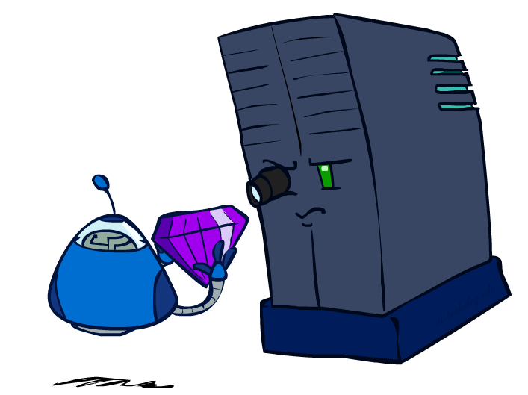
Evaluation Functions

Slide 26
Evaluation Functions
Evaluation functions score non-terminals in depth-limited search
Ideal function: returns the actual minimax value of the position
In practice: typically weighted linear sum of feature fuctions (you will see more later):
e.g. f₁(s) = (num white queens – num black queens), etc.

Slide 27
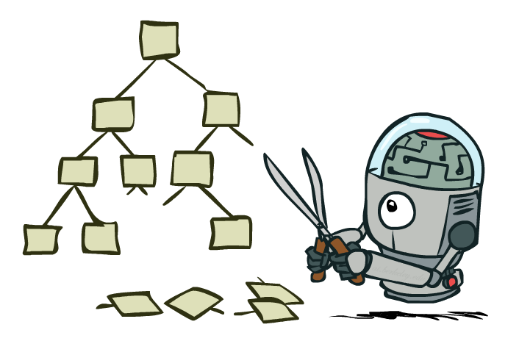
Game Tree Pruning
Ignore portions of search tree that make no difference to final choice

Slide 28
Minimax Example
3
12
8
2
4
6
14
5
2

Slide 29
Minimax Pruning
3
12
8
2
14
5
2

Slide 30
Alpha-Beta Pruning
General configuration (MIN version)
We’re computing the MIN-VALUE at some node n
We’re looping over n’s children
n’s estimate of the childrens’ min is dropping
Who cares about n’s value? MAX
Let a be the best value that MAX can get at any choice point along the current path from the root
If n becomes worse than a, MAX will avoid it, so we can stop considering n’s other children (it’s already bad enough that it won’t be played)
MAX version is symmetric
MAX
MIN
a
MAX
MIN
n

Slide 31
Alpha-Beta Pruning
MAX
MIN
≤ 3
Beta
Terminal
3

Slide 32
Alpha-Beta Pruning
Final score
Alpha
MAX
≥ 3
MIN
3
≤ 3
Terminal
3
12
8

Slide 33
Alpha-Beta Pruning
MAX
≥ 3
MIN
3
2
≤ 2
3 > 2 !!!
Terminal
3
12
8
2
No “final” score
But fine to tell MAX “2”

Slide 34
Alpha-Beta Pruning
MAX
≥ 3
MIN
3
2
≤ 14
3 > 14 ?
Terminal
3
12
8
2
14

Slide 35
Alpha-Beta Pruning
MAX
≥ 3
MIN
3
2
≤ 14
≤ 5
3 > 5 ?
Terminal
3
12
8
2
14
5

Slide 36
Alpha-Beta Pruning
MAX
3
≥ 3
MIN
3
2
2
≤ 14
≤ 5
≤ 2
Terminal
3
12
8
2
14
5
2
Note: Only showed MIN pruning here
In general, both MIN and MAX check Alpha > Beta, prune

Slide 37
Alpha-Beta Implementation
α: MAX’s best option on path to root so far: the lowest score MAX can possibly get
β: MIN’s best option on path to root so far: the highest score MIN can possibly get
def max-value(state, α, β):
initialize v = -∞
for each successor of state:
v = max(v, value(successor, α, β))
if v ≥ β return v
α = max(α, v)
return v
def min-value(state , α, β):
initialize v = +∞
for each successor of state:
v = min(v, value(successor, α, β))
if v ≤ α return v
β = min(β, v)
return v
Notes:
Pick an order for two reasons: sequential processor and pruning

Slide 38
Alpha-Beta Implementation
α: MAX’s best option on path to root so far: the lowest score MAX can possibly get
β: MIN’s best option on path to root so far: the highest score MIN can possibly get
def max-value(state, α, β):
initialize v = -∞
for each successor of state:
v = max(v, value(successor, α, β))
if v ≥ β return v
α = max(α, v)
return v
def min-value(state , α, β):
initialize v = +∞
for each successor of state:
v = min(v, value(successor, α, β))
if v ≤ α return v
β = min(β, v)
return v
Notes:
Pick an order for two reasons: sequential processor and pruning

Slide 39
Alpha-Beta Pruning Properties
This pruning has no effect on minimax value computed for the root!
Values of intermediate nodes might be wrong
Important: children of the root may have the wrong value
So the most naïve version won’t let you do action selection
Good child ordering improves effectiveness of pruning
With “perfect ordering”:
Time complexity drops to O(b^{m/2})
Doubles solvable depth!
Full search of, e.g. chess, is still hopeless…
This is a simple example of metareasoning (computing about what to compute)
max
min
10
10
0

Slide 40
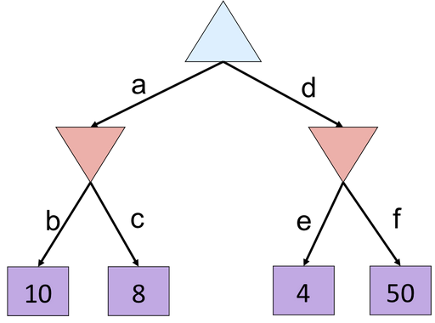
Exercise-1

Slide 41
Answer Exercise-1
8
8
4

Slide 42
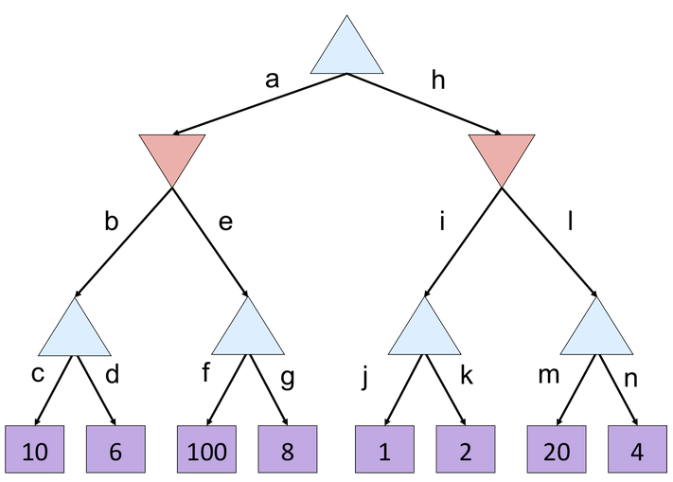
Exercise-2

Slide 43
Answer Exercise-2
10
10
2
10
100
2
20

Slide 44
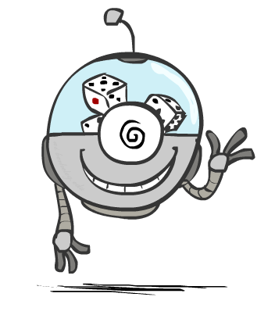
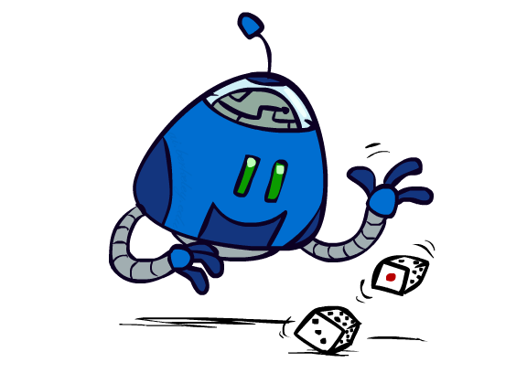
Uncertain Outcomes

Slide 45

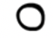

Worst-Case vs. Average Case
max
min
10
10
9
100
Idea: Uncertain outcomes controlled by chance, not an adversary!
Notes:
At least 10, or otherwise just rather dead; or just 100, or otherwise rather dead; that’s yet something different than minimax or expectimax

Slide 46
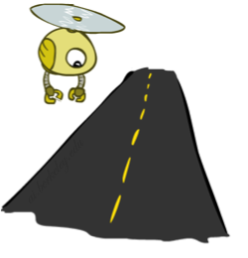
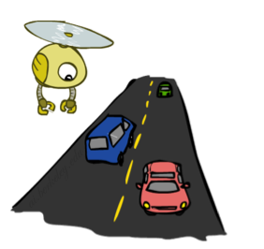
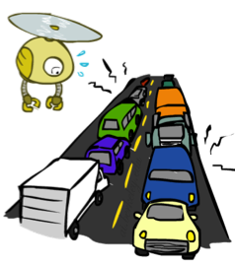
Reminder: Probabilities
A random variable represents an event whose outcome is unknown
A probability distribution is an assignment of weights to outcomes
Example: Traffic on freeway
Random variable: T = whether there’s traffic
Outcomes: T in {none, light, heavy}
Distribution: P(T=none) = 0.25, P(T=light) = 0.50, P(T=heavy) = 0.25
Some laws of probability (more later):
Probabilities are always non-negative
Probabilities over all possible outcomes sum to one
As we get more evidence, probabilities may change:
P(T=heavy) = 0.25, P(T=heavy | Hour=8am) = 0.60
We’ll talk about methods for reasoning and updating probabilities later
0.25
0.50
0.25

Slide 47
Reminder: Expectations
The expected value of a function of a random variable is the average, weighted by the probability distribution over outcomes
Example: How long to get to the airport?
Time:
20 min
30 min
60 min
+
+
35 min
x
x
x
Probability:
0.25
0.50
0.25

Slide 48
Expectimax Search
Why wouldn’t we know what the result of an action will be?
Explicit randomness: rolling dice
Unpredictable opponents: the ghosts respond randomly
Actions can fail: when moving a robot, wheels might slip
Values should now reflect average-case (expectimax) outcomes, not worst-case (minimax) outcomes
Expectimax search: compute the average score under optimal play
Max nodes as in minimax search
Chance nodes are like min nodes but the outcome is uncertain
Calculate their expected utilities
I.e. take weighted average (expectation) of children
max
chance
10
10
4
10
5
9
7
100

Slide 49
Expectimax Pseudocode
def value(state):
if the state is a terminal state: return the state’s utility
if the next agent is MAX: return max-value(state)
if the next agent is EXP: return exp-value(state)
def max-value(state):
initialize v = -∞
for each successor of state:
v = max(v, value(successor))
return v
def exp-value(state):
initialize v = 0
for each successor of state:
p = probability(successor)
v += p * value(successor)
return v
Notes:
Pick an order for two reasons: sequential processor and pruning

Slide 50
Expectimax Pseudocode
def exp-value(state):
initialize v = 0
for each successor of state:
p = probability(successor)
v += p * value(successor)
return v
1/2
1/6
1/3
5
8
7
24
-12
v = (1/2) (8) + (1/3) (24) + (1/6) (-12) = 10

Slide 51
Expectimax Example
3
12
9
2
4
6
15
6
0

Slide 52
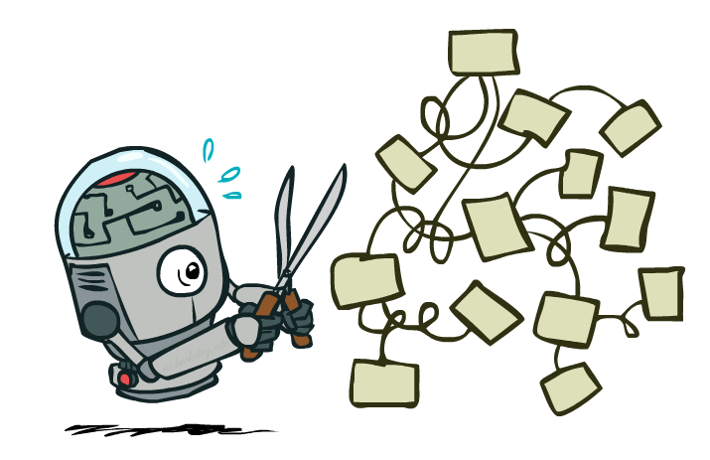
Expectimax Pruning?
3
12
9
2

Slide 53



Depth-Limited Expectimax
400
300
…
Estimate of true expectimax value (which would require a lot of work to compute)
…
492
362
…

Slide 54

Modeling Assumptions

Slide 55
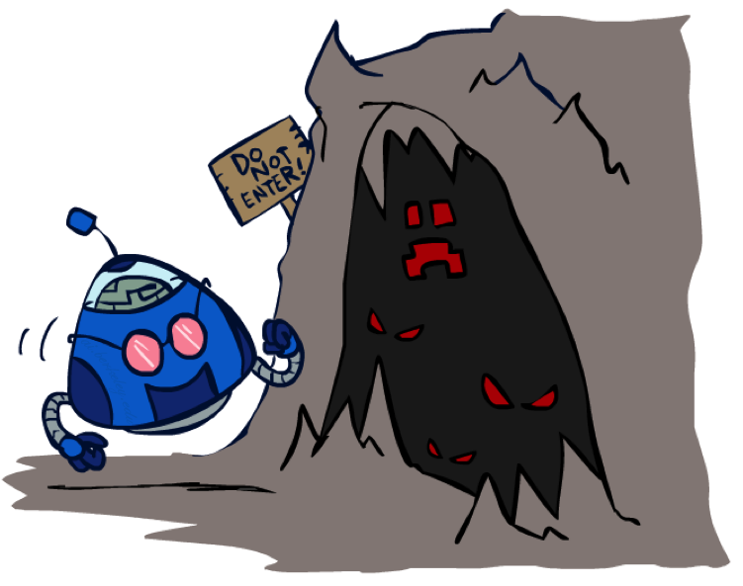
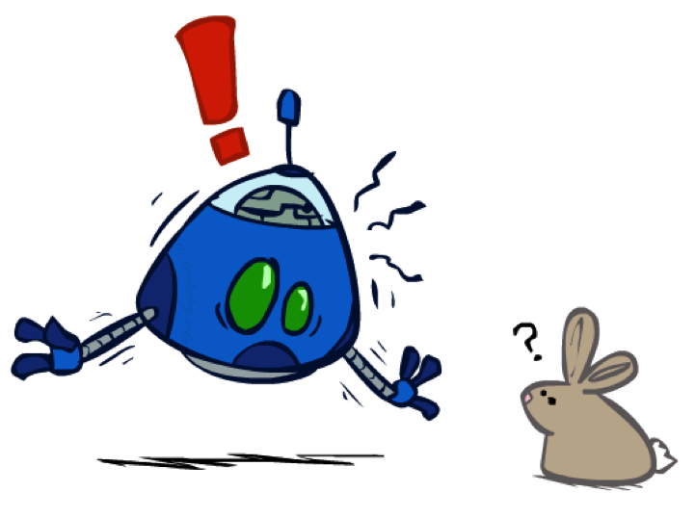
The Dangers of Optimism and Pessimism
Dangerous Optimism
Assuming chance when the world is adversarial
Dangerous Pessimism
Assuming the worst case when it’s not likely

Slide 56
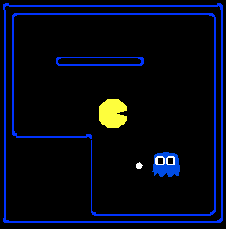
Assumptions vs. Reality
 | Adversarial Ghost | Random Ghost
Minimax Pacman | Won 5/5 Avg. Score: 483 | Won 5/5 Avg. Score: 493
Expectimax Pacman | Won 1/5 Avg. Score: -303 | Won 5/5 Avg. Score: 503
Results from playing 5 games
Pacman used depth 4 search with an eval function that avoids trouble
Ghost used depth 2 search with an eval function that seeks Pacman
Notes:
python pacman.py -g SmartGhost -l trapped2 -p ExpectimaxAgent -a depth=4,evalFn=better

Slide 57
Uncertainty Everywhere
Not just for games of chance!
I’m sick: will I sneeze this minute?
Email contains “FREE!”: is it spam?
Tooth hurts: have cavity?
60 min enough to get to the airport?
Robot rotated wheel three times, how far did it advance?
Safe to cross street? (Look both ways!)
Sources of uncertainty in random variables:
Inherently random process (dice, etc)
Insufficient or weak evidence
Ignorance of underlying processes
Unmodeled variables
The world’s just noisy – it doesn’t behave according to plan!
Compare to fuzzy logic, which has degrees of truth, rather than just degrees of belief

